Slide 1
BECOMING -Michelle Obama
Submitted To:

Slide 2
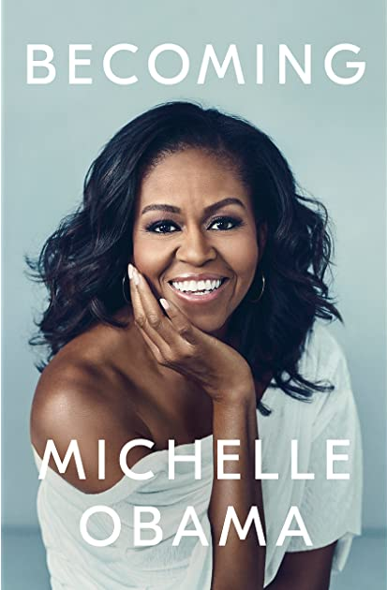
ABOUT THE BOOK
‘Becoming’ is the autobiography of the former First Lady of The United States of America, Michelle Obama. The book was released in 2018. It is published by Crown and was released in 24 languages. One million copies were donated to First Book, an American nonprofit organization which provides books to children. It was the highest-selling books published in the United States in 2018, setting the record 15 days after its publication, with over two million copies sold.
The book has received several awards including Grammy Awards for Best Spoken Word Album, Audie Award for Autobiography and NAACP Image Award for Outstanding Literary Work – Auto-biography.

Slide 3
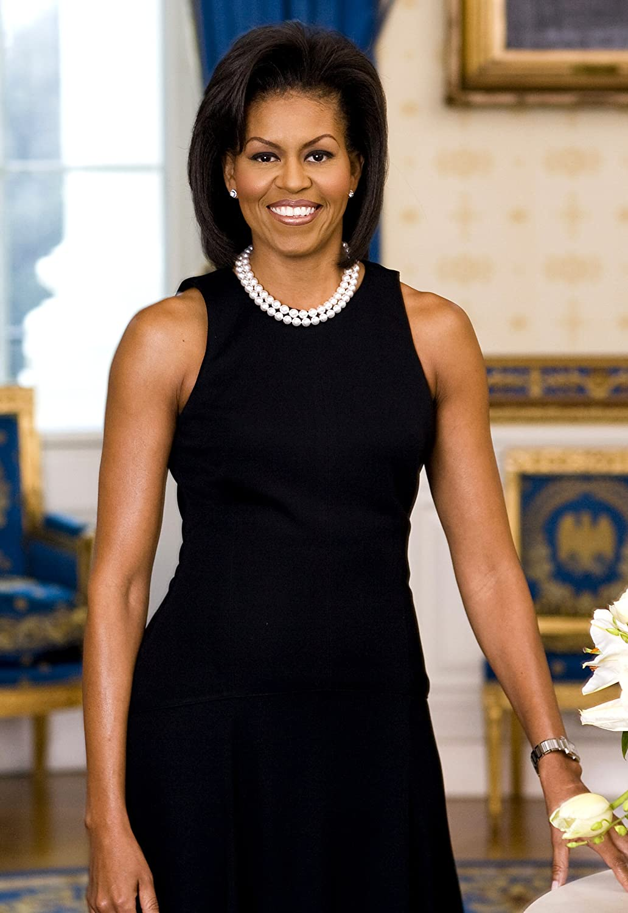
ABOUT THE AUTHOR
Michelle LaVaughn Robinson Obama was born on January 17, 1964. She is an American attorney and an author who served as the First Lady of the United States from 2009-2017. She was the first African-American woman to serve in this position. She is married to the 44th President of the United States, Barack Obama. They have two daughters, Malia Ann and Natasha.
Michelle was raised on the South Side of Chicago, Illinois. She is a graduate of Princeton university and Harvard Law school. She has worked as an associate dean of Student Services at the University of Chicago as well as the vice president for Community and External Affairs of the University of Chicago Medical Center.
She worked as an advocate for poverty awareness, education, nutrition, physical activity, healthy eating. She is a role model for women across the world. In 2020, she topped Gallup’s poll of the most admired woman in America for the third year running.

Slide 4
THEME
The main theme of the book ‘BECOMING’ is Michelle’s dedication to personal growth and aspirations and her persistence despite the various setbacks. She talks about racial discrimination and segregation.
Also, she talks about family unity and how despite all the chaos in her life she found solace with her family. She also mentioned the obstacles she faced while being a working professional and parenting and how she balanced the two.
Another major point that she took up was the nasty side of politics. Politics opened her family to media criticism and scrutiny.

Slide 5
PLOT/SUMMARY
Michelle begins her book by providing a glance of her early life as an African American woman growing up in Chicago in a brick bungalow belonging to her mother’s aunt and her husband. During the riots set off after Martin Luther King’s assassination, she was protected under the umbrella of her family. For her, her family was the core of everything. She loved art and jazz. Michelle also informs the readers that music runs in her family and she decided to learn piano at the age of 4.
When Michelle talks about her education, the reader finds evidence of how much she loved to learn and how determined, persistent and a brilliant child she was. Attaining a dime-sized gold-foil trophy in elementary school was a great achievement to Michelle, and she walked with her head held high that afternoon. Michelle went to study at Harvard and then began working for a law firm in Chicago which she eventually left as she felt dissatisfied in her job.

Slide 6
Her family was very poor but still coped with what they had and strived to provide their kids with the best life they could afford. She revealed the level of racial segregation and disparities between Chicago’s downtown and its south side. She uses her story to introduce the readers to the complexity and richness of African American history, something that has hardly reached the international audience.
She had a habit ”to keep a close and high spirited council of friends” which she referred as “safe harbor of female wisdom”. Czerny was the perfect example and friend to Michelle throughout college, helping set the standard for her successful life. She lost her friend Suzzane to cancer.
Though she was skeptical about politics she was excited for her job at City Hall as she wanted to actually improve people’s lives.
She met Barack Obama at the law firm in Chicago. Although she had some initial doubts about him, she quickly caught on and they were eventually married in 1992. She states that she noted Barack’s intense optimism, his diligence and also his humility. He seemed more concerned with a broader “potential for mobility” than his own wealth.

Slide 7
Sometime later Barack won a seat in the Illinois Senate. Michelle moved on to a job at the University of Chicago, as an associate dean focusing on community relations.
Later in 1998, they had their first daughter, Malia. After her, Michelle and Barack’s life changed tremendously. Michelle had a difficult time adjusting to the schedule of being a mom and also having a part-time job. When they were on a vacation in Hawaii, Malia fell ill and Barack was forced to miss a crime bill vote because they could not fly home while she was sick. This was one of those times Michelle saw the nasty side of politics as he was critized for his action and lost a Congressional race.
In 2001, they had another daughter. Sasha. Michelle firstly debated on getting back to work but worked a job with the University of Chicago Medical Center.
Barack got a few lucky breaks along the way to run for the U.S. Senate. In the 2004 Democratic National Convention, he gave a rousing seventeen-minute speech demonstrating how he is the embodiment of the American dream, calling for hope, progress, and unity among the American people. He became an instant sensation and won his senate race with 70 percent of the vote. Along Barack’s entire journey of becoming a president, there were various moments that Michelle felt she was losing her identity but kept on being one of the greatest pillars. During the campaign trail, they faced scrutiny. People even spoke about her “emasculating” Barack by being such a strong woman.

Slide 8
As soon as Barack won the presidency, he focused on rescuing a failing economy, while Michelle began a series of initiatives in the White House. She started promoting children’s health, although she was sure to receive some backlash.
Over the course of Barack’s two terms as a President, both Michelle and Barack accomplish a lot. Still, there are many instances in which they weren’t able to achieve all of their goal and they felt the weight and responsibility of caring for a grieving nation. As Barack’s presidency drew to close, the next election kicked up and Michelle helped campaign for Hillary Clinton, primarily because she didn’t appreciate the racist and misogynistic comments that Donald Trump made.
Michelle concluded by affirming that she is “an ordinary person who found herself on an extraordinary journey”. She believes that neither her, nor her country is perfect, but continuing to grow, owning one’s own unique story, is what ‘becoming’ ultimately means.

Slide 9
FAV. QUOTES FROM THE BOOK
If you don’t get out there and define yourself, you’ll be quickly and inaccurately defined by others.
Most of us lived in a state of constant calibration, tweaking one area of life in hoped of bringing more steadiness to another.
Failure is a feeling long before it becomes an actual result. It’s a vulnerability that breeds with self-doubt and then is escalated, often deliberately, by fear.
It was possible that I was more in charge of my happiness than I was allowing myself to be.
I wasn’t going to let one person’s opinion dislodge everything I thought I knew about myself.
Inspiration on its own is shallow. You have to back it up with hard-work.
For me, becoming isn’t about arriving somewhere or achieving a certain aim. I see it instead as forward motion, a means of evolving, a way to reach continuously toward a better self. The journey doesn’t end.

Slide 10
MY VIEWS
The book “Becoming” introduces an entirely different picture of Michelle Obama. She provides a first-hand meaning to the term “First Lady”. She is an assertive, smart and a strong woman who was good enough to set the norm for the future generations o f First ladies.
The book also gives a new perspective on the couple. Michelle was indeed a reason for Barack to go on and accomplish his dreams while as an individual she accomplished hers as well.
At some points, she is a highly relatable character whereas there are moments when she is an idealistic person. Initially she faced difficulties in striking a balance between the demands of a First Lady and motherhood.
The book thoughtfully covers Michelle’s life from Chicago to her life in the White House. She never takes any of it for granted. On the contrary, her tone is one of wonderment as to how this all happened.
On a concluding note, it can be said that the book was inspiring and made sure that readers appreciate their unique selves, identify and work for their dreams. She talks about her family so beautifully and the way she manages professional and personal life which makes the reader look back and acknowledge the support of their families.

Slide 11
Thank You

